Slide 1
Machine Learning 101
Big Data Juan Rodriguez, NYU
Source: Databricks, Cloudera, https://medium.com/@Sushil_Kumar/machine-learning-pipelines-with-spark-ml-94cd9b4c973d

Slide 2
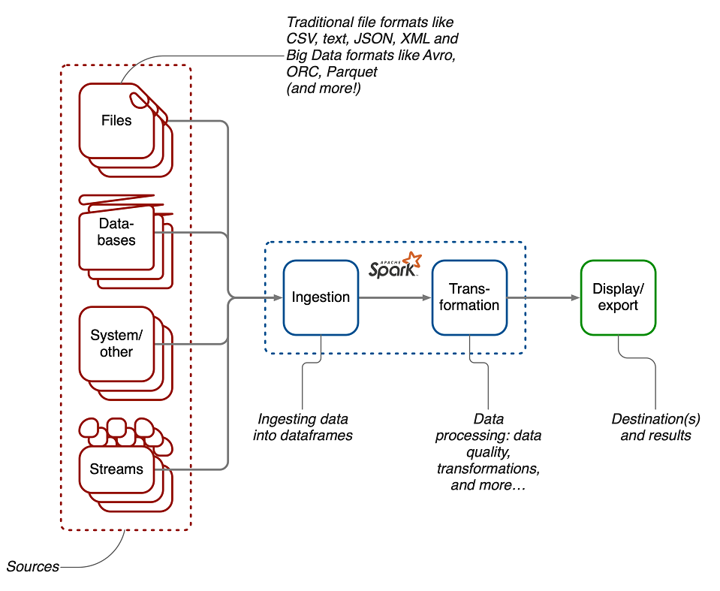
Spark (Review)

Slide 3
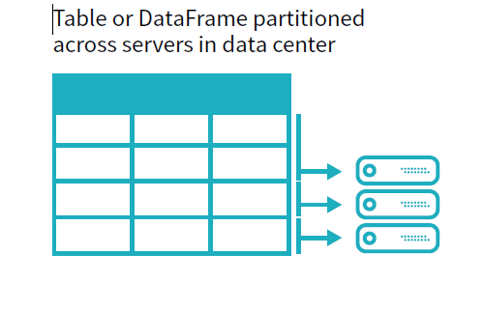
Spark (Review)
Dataframe:

Slide 4
Spark (Review)
2 types of operations
TRANSFORMATIONS
Dataframes are immutable. Transformations -> new Dataframe
Because of Lazy Evaluations, nothing is physically materialized until…
ACTIONS
Force/trigger a computation

Slide 5
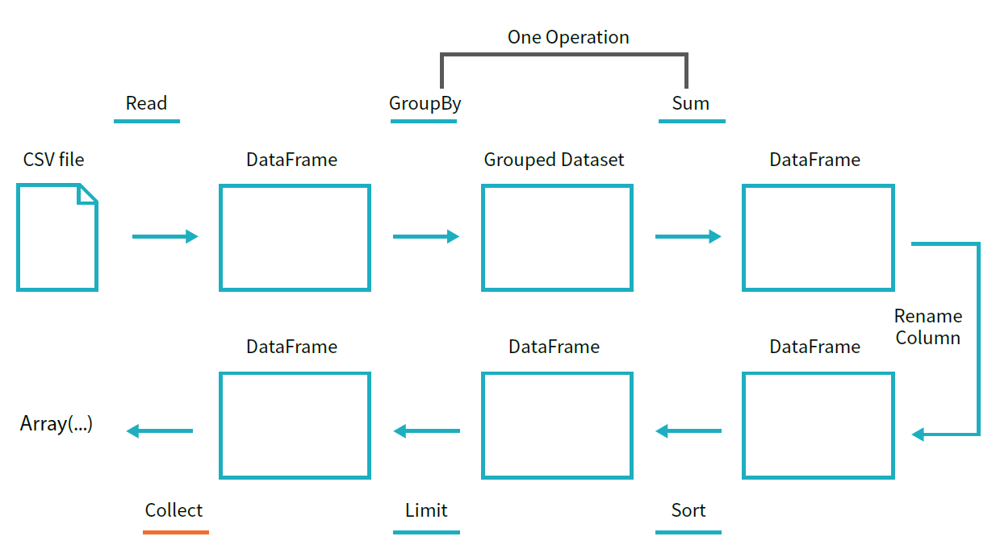
Spark (Review)

Slide 6
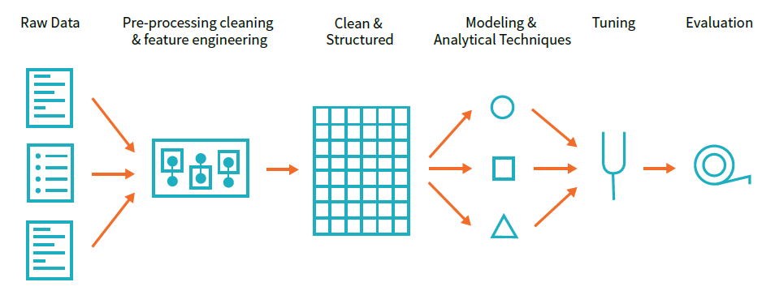
ML workflow

Slide 7
Some ML Tools (for big data)
Apache Spark: MLlib https://spark.apache.org/docs/latest/ml-guide.html
H2O https://www.h2o.ai/
R
SparkR https://spark.apache.org/docs/latest/sparkr.html
dplyr (Spark)
native https://www.datacamp.com/community/tutorials/machine-learning-in-r
Knime https://www.knime.com/

Slide 8
Spark, Spark ML
There are two Spark Machine Learning libraries:
ML (DataFrame based)
MLLib (RDD based – which is in maintenance mode now)
org.apache.spark.ml is the Scala package name

Slide 9
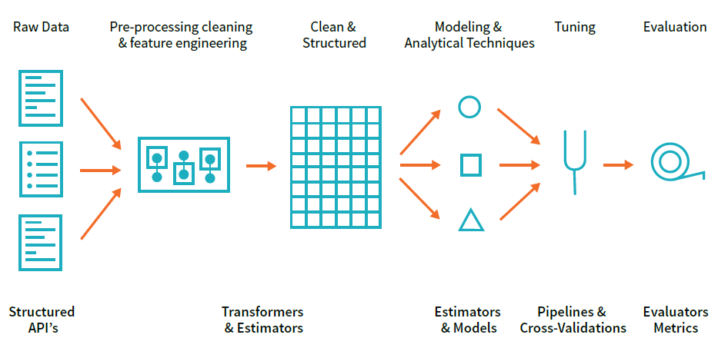
Spark ML

Slide 10
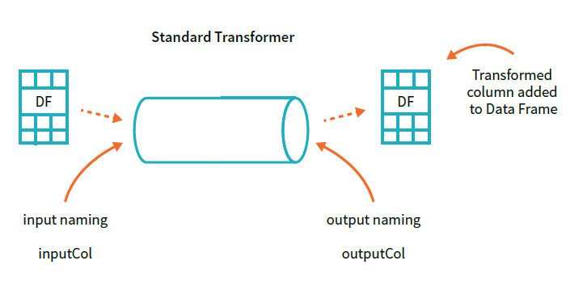
Transformers
functions that convert raw data in some way
primarily used in preprocessing or feature generation
technically, a Transformer implements a method transform(), which converts one DataFrame into another, generally by appending one or more columns
immutable

Slide 11


Slide 12
Transformers
StringIndexer
IndexToString
OneHotEncoder
VectorIndexer
Tokenizer
StopWordsRemover

Slide 13
StringIndexer
features must be of type Double but we have a few features which are of the type String
StringIndexer is a transformer, which encodes a string column of labels to a column of label indices.
Indices are in (0, numLabels)
Ordered by label frequencies, so the most frequent label gets index 0.
Fit method converts the column to StringType and then counts the occurrence of each word. It then sorts these words in descending order of their frequency and assigns an index to each word.

Slide 14
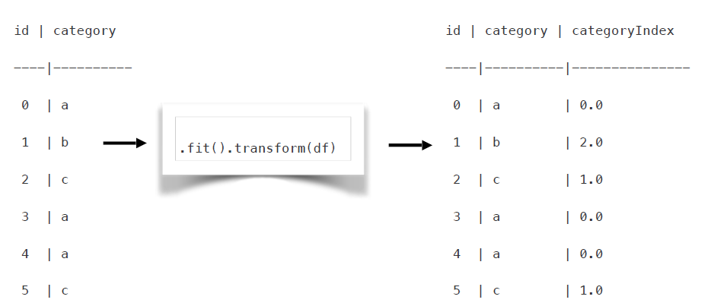
StringIndexer

Slide 15
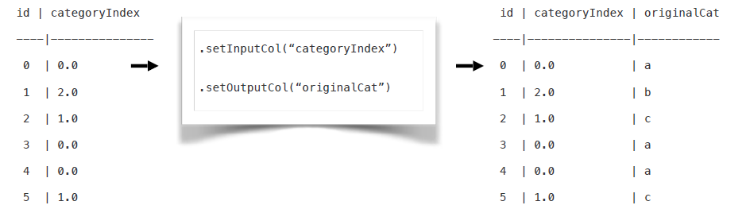
IndexToString
Maps a column of label indices back to a column containing the original labels as Strings.
A common use case is to produce indices from labels with StringIndexer, train a model with those indices and retrieve the original
labels from the column of predicted indices with IndexToString.
labels: Optional -> param for array of labels specifying index-string mapping

Slide 16
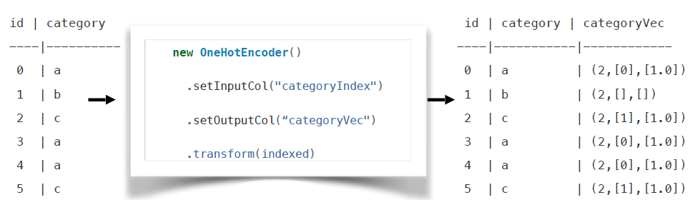
OneHotEncoder
Maps a column of label indices back to a column of binary vectors, with at most a single one-value.
Allow algorithms to use categorical features.
Used to distinguish each word in a vocabulary from every other word in the vocabulary.

Slide 17
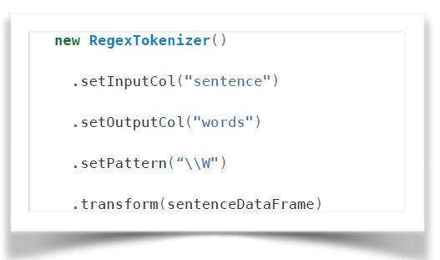
Tokenizer
Tokenization is the process of taking text (such as a sentence)
and breaking it into individual terms (usually words).
RegexTokenizer allows more advanced tokenization based on regular expression (regex) matching.
gaps
minTokenLength
pattern
toLowerCase

Slide 18
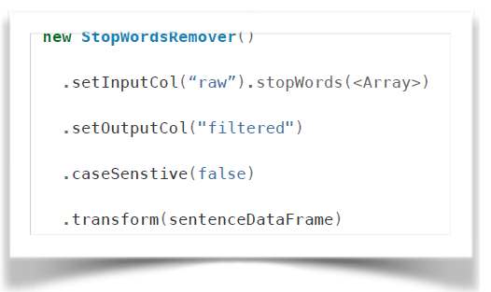
StopWordsRemover
StopWords are the words which should be excluded from the input

Slide 19
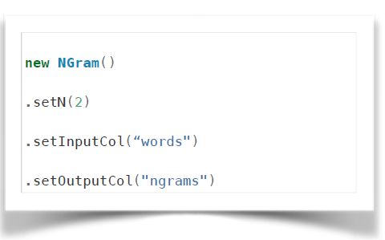
N-grams
An n-gram is a sequence of n tokens (typically words) for some integer n.
The parameter n is used to determine the number of terms in each n-gram.gap.
n

Slide 20
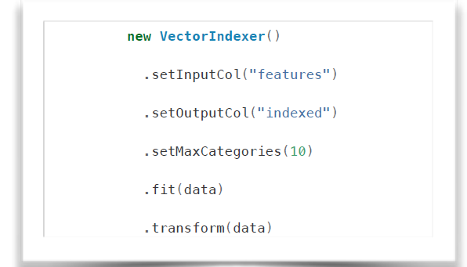
VectorIndexer
VectorIndexer helps index categorical features in datasets of Vectors.
It can both automatically decide which features are categorical and convert original values to category indices. Used to distinguish each word in a vocabulary from every other word in the vocabulary.
maxCategories

Slide 21
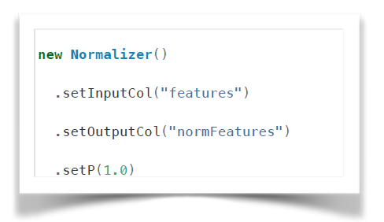
Normalizer
Normalizer is a Transformer which transforms a dataset of Vector rows, normalizing each Vector to have unit norm.
takes parameter p, which specifies the p-norm used for normalization.
normalization can help standardize input data and improve the behavior of learning algorithms.

Slide 22
More Transformers….
Binarizer
PCA
Polynomial Expansion
Discrete Cosine Transform
Bucketizer
QuantileDiscretizer
StandardScaler, MinMaxScaler, MaxAbsScaler
LDA
….

Slide 23
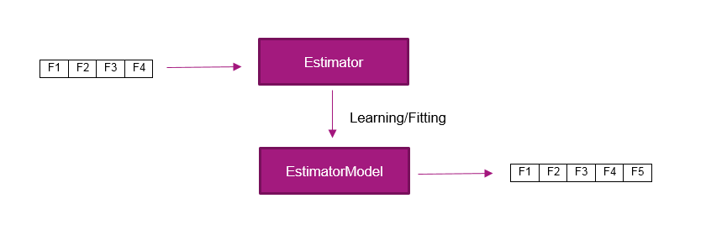
Estimators
an Estimator abstracts the concept of a learning algorithm or any algorithm that fits or trains on data
technically, an Estimator implements a method fit(), which accepts a DataFrame and produces a Model, which is a Transformer.
for example, a learning algorithm such as LogisticRegression is an Estimator, and calling fit() trains a LogisticRegressionModel, which is a Model and hence a Transformer

Slide 24
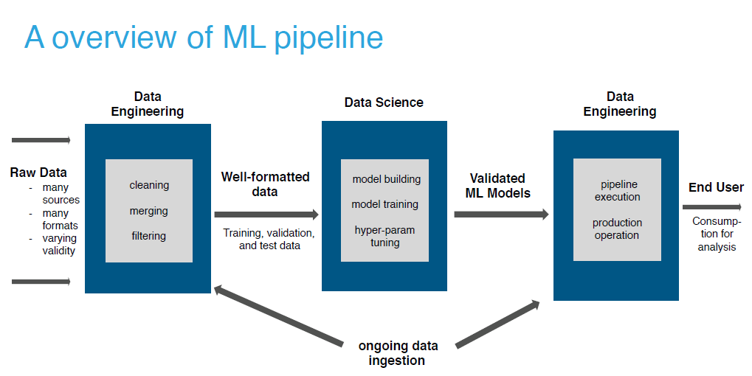
Source: cloudera

Slide 25
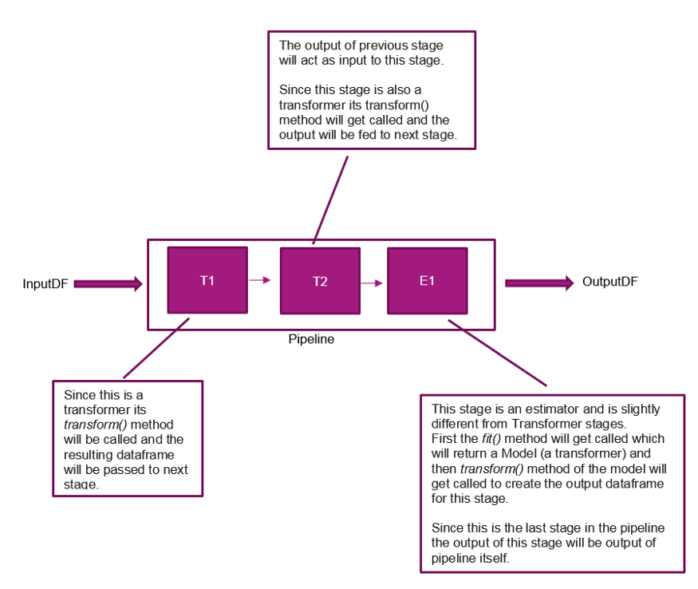

Slide 26
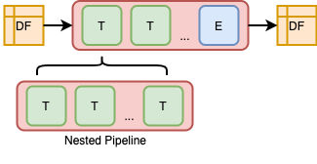
https://towardsdatascience.com/pipeline-oriented-data-analytics-with-spark-ml-part-2-3088d7a3c1b5

Slide 27
Machine Learning - Summary
Tools
Spark ML
Knime
H2O
R/R-Studio
rattle
h2o
Mlr
SparkR

